Slide 1
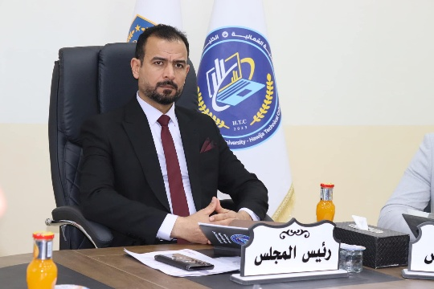
Al-Huwayjah Technical College
Al-Huwayjah Technical College offers professional training programs in various fields, aiming to qualify specialized professional cadres.

Slide 2
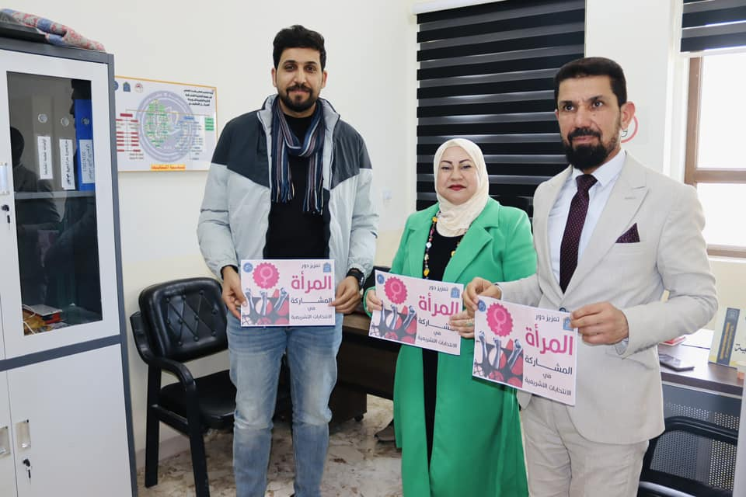
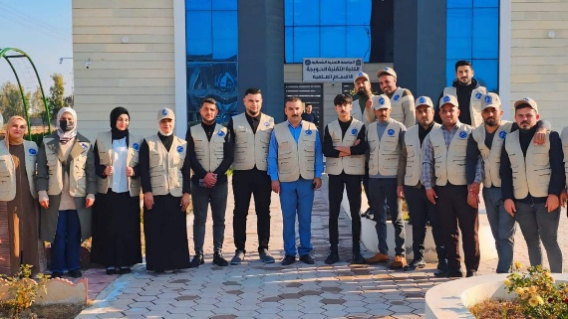
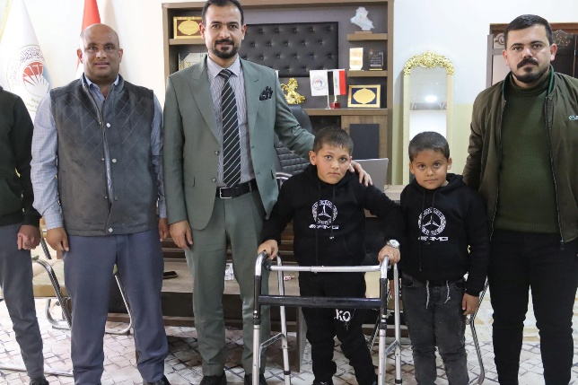
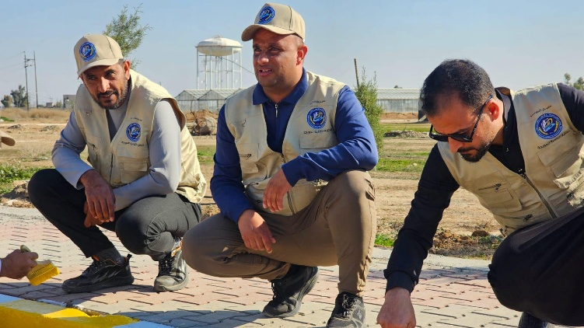
Events and Activities

Slide 3
Vision of Al-Huwayjah Technical College
The college's vision is to lead to innovation and provide high-quality educational programs and services within future foundations that are in line with modern developments by acquiring high technical and professional expertise and harnessing it scientifically and academically according to an advanced methodological perspective, in addition to opening specialized courses in the administrative, financial and engineering labor market.

Slide 4
Al-Huwayjah Technical College Message
To be a leading and innovative technical college in providing high quality educational programs and services, in a highly competitive and highly technical scientific environment.

Slide 5
Objectives of Al-Huwayjah Technical College
Preparing qualified scientific and practical cadres capable of dealing with modern technologies in a manner consistent with the changes occurring in the labor market and adapting to the changing needs of students and organizations, and continuing to offer curricula and study materials that focus on education for the purpose of description and providing and maintaining facilities, equipment and technical services as a necessity to support a creative educational environment that keeps pace with developments.

Slide 6
Study in college initiative
The “Study at Al-Huwaija Technical College” initiative aims to encourage young people to join the various academic and training programs offered by the college. The initiative seeks to provide distinguished educational opportunities in technical and vocational specializations, which helps students develop their skills and meet the needs of the local and international labor market. The initiative also contributes to raising awareness of the importance of technical education in building a sustainable professional future.

Slide 7
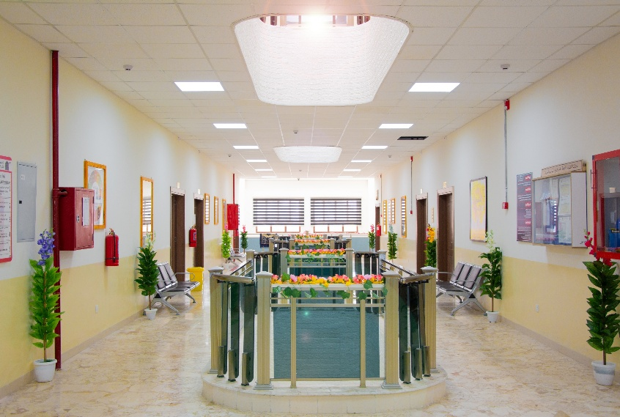
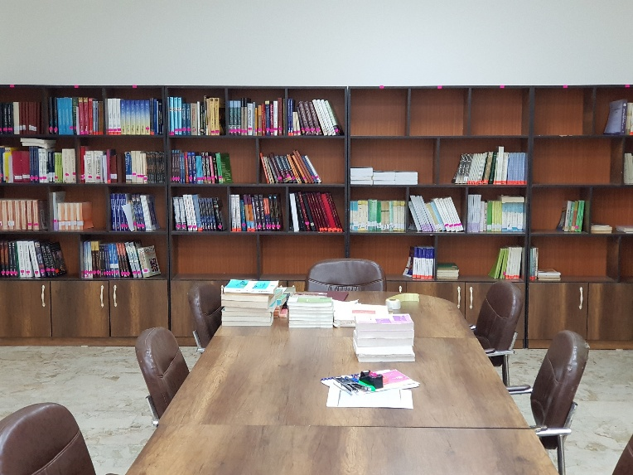
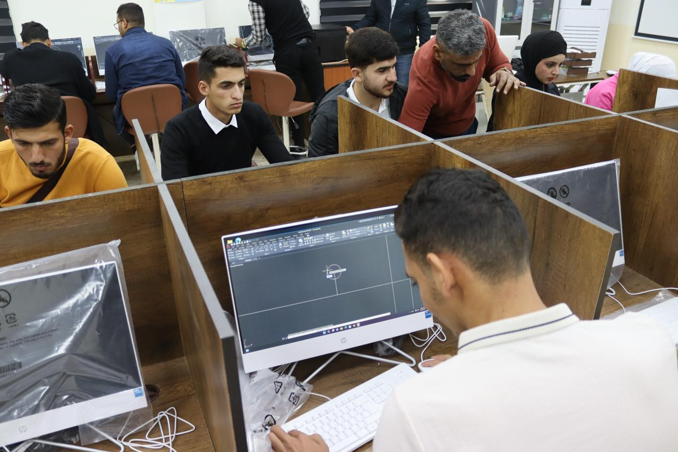
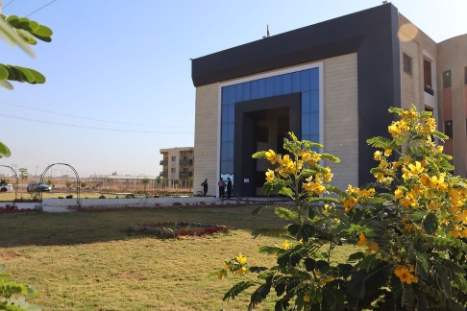
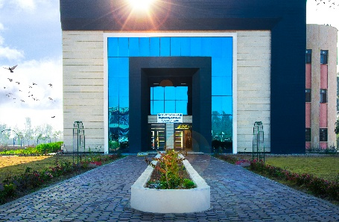
Study at Al-Hawija Technical College Initiative

Slide 8
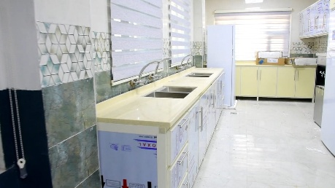
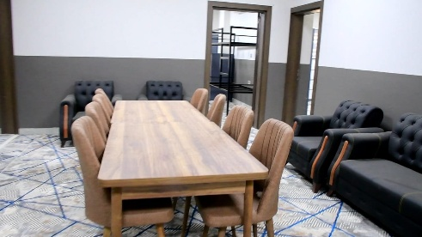
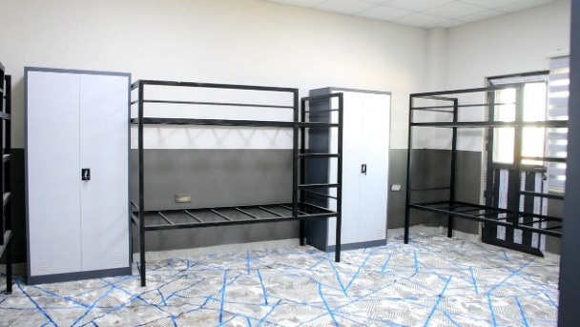
Study at Al-Hawija Technical College Initiative
Al-Huwaijah Technical College provides equipped dormitories for students, with the aim of providing a comfortable and safe residential environment. These dormitories include rooms equipped with all basic needs, such as beds, desks, and internet services, in addition to service facilities such as restaurants, study halls, and sports fields. The dormitory management is also committed to providing a suitable environment for study and comfort, while providing continuous support to students to ensure an integrated residential experience.

Slide 9
Scientific departments
Al-Huwaijah Technical College includes several specialized scientific departments that aim to provide students with the knowledge and technical skills required in the labor market. These departments include:
Department of Financial and Banking Technologies - focuses on studying modern financial and banking systems, and qualifies students to work in the banking and financial sectors.
Department of Business Administration Technologies - is concerned with developing management, planning, and organizational skills in institutions and companies.
Department of Mechatronics Engineering Technologies - combines mechanical, electronic, and information technology engineering to design smart and advanced systems. These departments contribute to providing students with the technical and scientific skills necessary to keep pace with the requirements of the modern labor market.

Slide 10
Scientific departments

Slide 11
Seminars and workshops
Al-Huwaija Technical College organizes many scientific and training seminars and workshops that aim to develop the academic and practical skills of students and faculty members. These events include:
Scientific seminars - discussing the latest developments in technical fields such as financial technologies, business administration, and mechatronics.
Training workshops - providing practical training on modern software, management systems, and advanced engineering technologies.
Awareness lectures - covering topics such as entrepreneurship, personal skills development, and work ethics.Joint events with institutions and companies - to enhance cooperation between the college and the labor market through training courses and research projects.
These seminars and workshops contribute to developing professional capabilities and enhancing innovation among students and graduates.

Slide 12
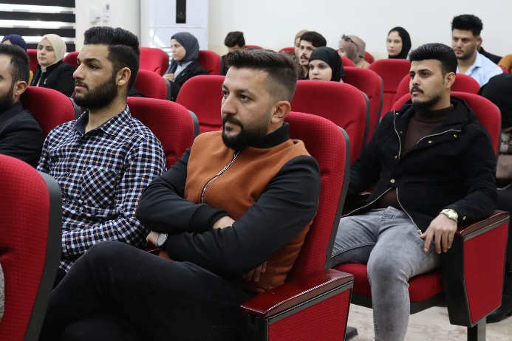
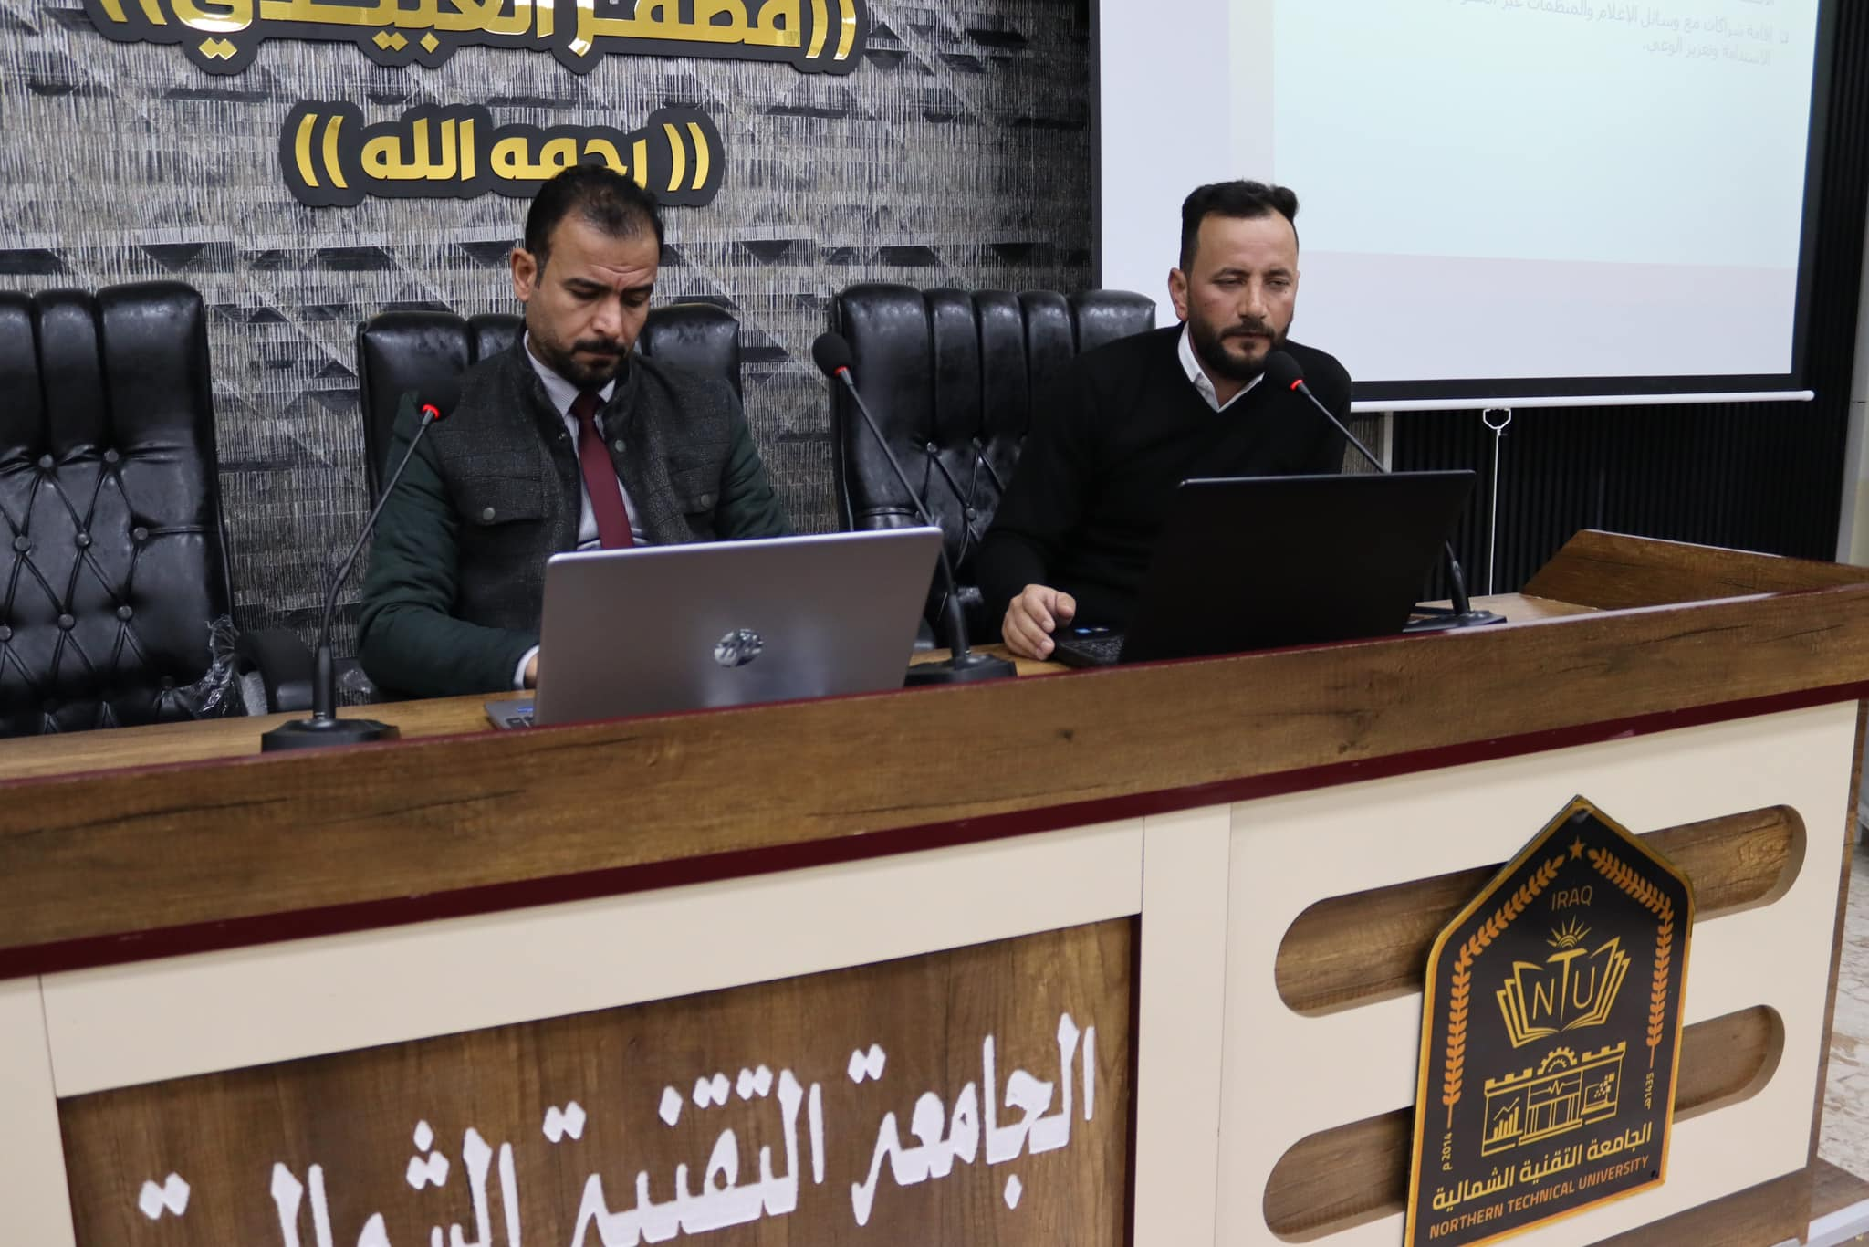
Workshops and seminars

Slide 13
Best regards, M. Website Unit of Al-Huwayjah Technical College

